Slide 1
ANOVA
Comparing means of more than 2 groups
Brian Stock
03.26.17

Slide 2
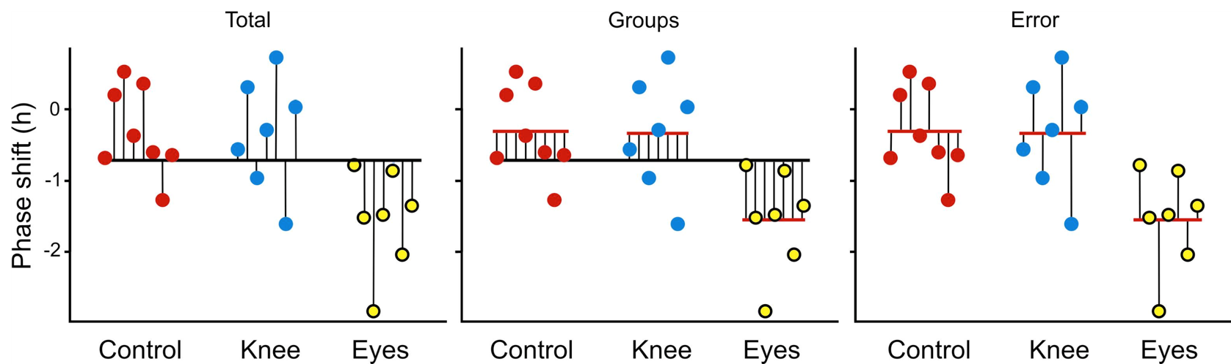
ANOVA = Analysis of variance
How much of the total variance is from differences in group means?
Total = Group + Error
No variance between groups = all group means are the same

Slide 3
ANOVA hypotheses
H₀ : Variance among groups = 0
H₀ : μ₁ = μ₂ = μ₃ = μ₄ = ... μ_{k}
H_{A}: Variance among groups is not 0
H_{A}: at least one population mean is different

Slide 4
H₀: all populations have equal means
H_{A}: at least one population mean is different.

Slide 5
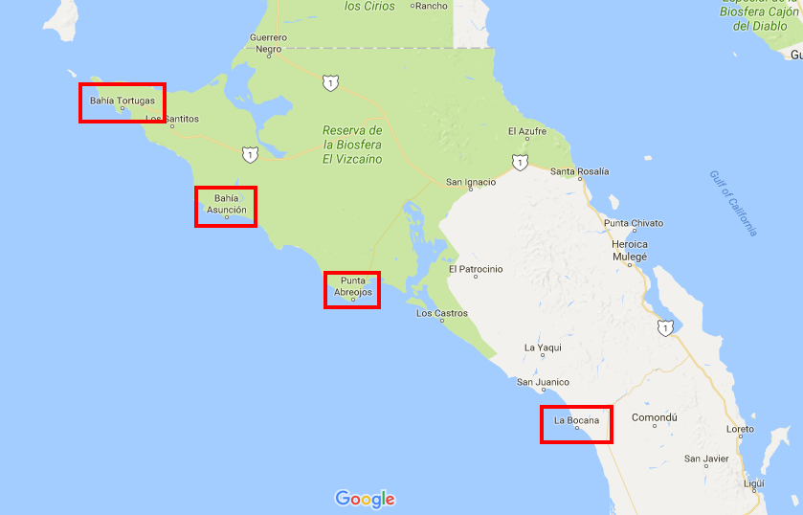
EX: catch/day at 4 sites

Slide 6
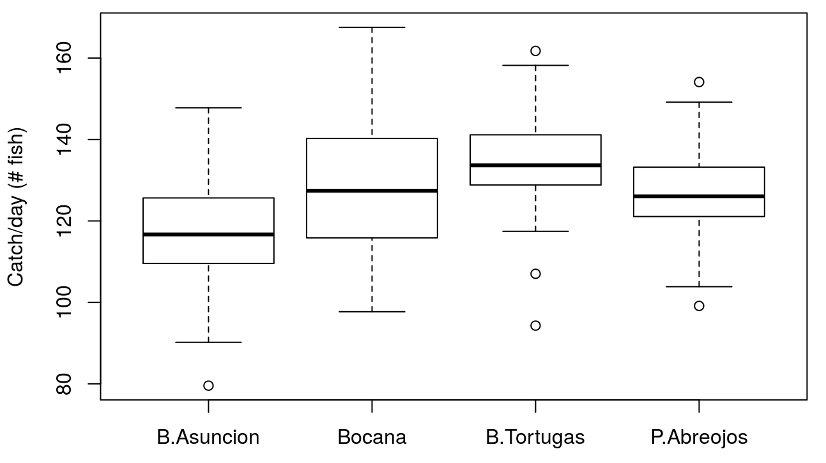
EX: catch/day at 4 sites

Slide 7
Assumptions
Random samples
Each group is normally distributed
But “surprisingly robust” – Central Limit Theorem
Each group has equal variance (Homoscedasticity)
Robust if sample sizes are large and equal, up to 10-fold difference in variances
Notes:
I don’t make them learn "Homoscedasticity". I just like saying it in public.

Slide 8
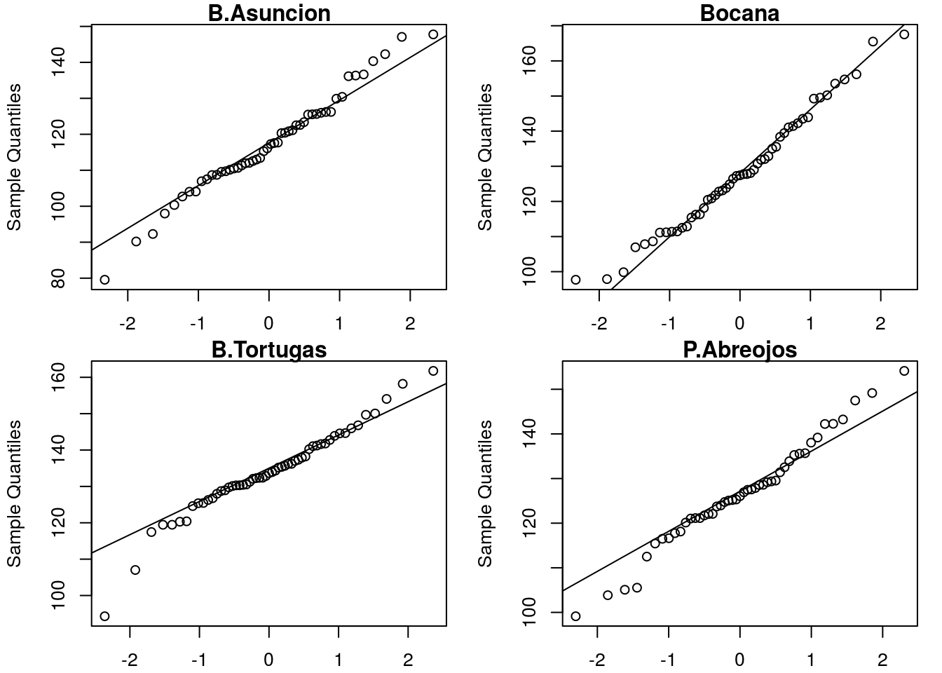
Is each group normal-distributed?

Slide 9
Are variances roughly equal?
N = 50
N = 51
N = 55
N = 47

Slide 10
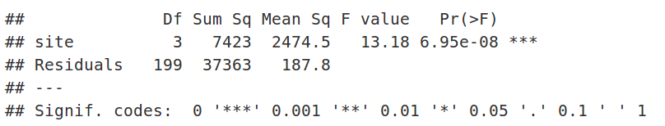
Great, let’s do an anova!
Df = degrees of freedom

Slide 11
Great, let’s do an anova!
Sum sq = Sum of squares = variance

Slide 12
Great, let’s do an anova!
Mean Sq = Mean Squares = Sum Sq / Df

Slide 13
Great, let’s do an anova!
F = F-statistic = Mean Sq Group / Mean Sq Residuals
If there is no difference, F <= 1

Slide 14
Great, let’s do an anova!
Pr(>F) = p-value
If there IS a difference, p < 0.05

Slide 15
So what?
All an ANOVA tells us is that one of the group means is different from the rest…
What else might we want to know?

Slide 16
Multiple comparisons
Probability of a Type I error in N tests =
1-(1-α)^{N}
For 20 tests, the probability of at least one Type I error is ~65%
Yikes!

Slide 17
"Bonferroni correction" for multiple comparisons
Uses a smaller α value:
Notes:
But this is extremely conservative

Slide 18
Which groups are different?

Slide 19
Tukey-Kramer test
Done after finding variation among groups with 1-factor ANOVA
Compares all group means to all other group means
“pairwise”

Slide 20
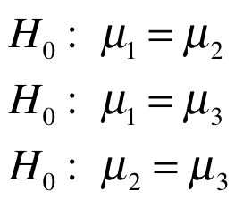
TUKEY Null hypotheses
…

Slide 21
Why not use a series of two-sample t-tests?
Multiple comparisons would cause the t-tests to reject too many true null hypotheses.
Tukey-Kramer adjusts for the number of tests.
Tukey-Kramer also uses information about the variance within groups from all the data, so it has more power than a t-test with a Bonferroni correction.

Slide 22
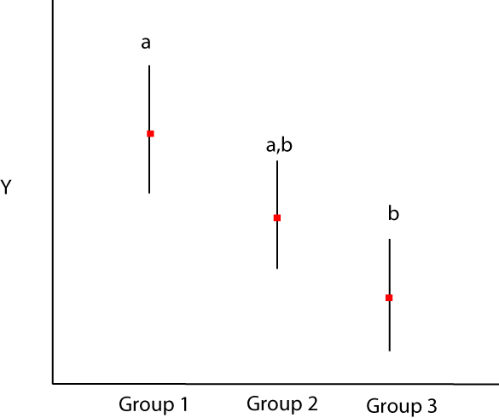
Letters show tukey results
Cannot reject
Reject
Cannot reject
Notes:
The middle group cannot be distinguished from the first or third groups, even though group 1 and group 3 are significantly different.

Slide 23

Letters show tukey results

